Slide 1
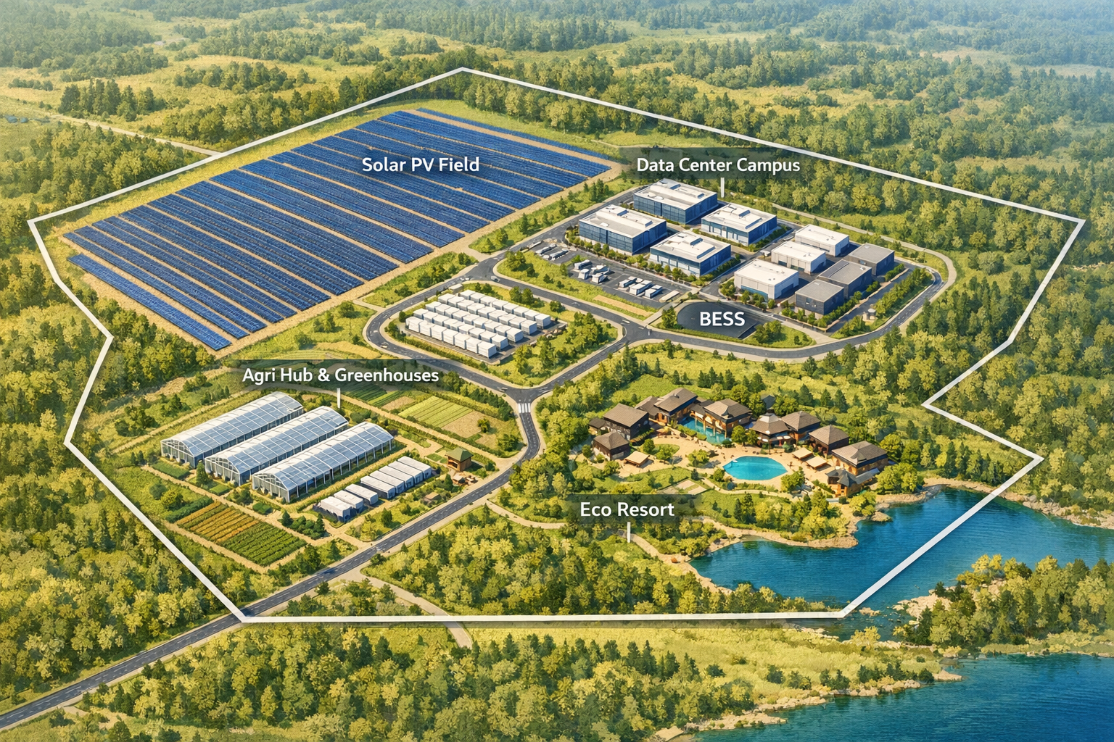
FLEXERA
Integrated Energy + Data Infrastructure Solar PV • BESS • Ice Thermal Storage • Data Centers • VPP-as-a-Service
Confidential | FLEXERA Investor Deck

Slide 2
The problem
Power volatility, grid congestion, and data demand are colliding.
Developers need bankable clean power with firm capacity.
Data centers require reliability, cooling, and fast interconnect.
Utilities need flexible demand + distributed assets to stabilize the grid.
Confidential | FLEXERA

Slide 3
Our solution
A modular campus that stacks revenues across energy, data and flexibility.
Solar PV
Utility-scale ground PV + rooftop + canopies
BESS
Dispatchable storage for firming + ancillary services
Ice Storage
Shifts cooling load, reduces peak demand (PUE impact)
Data Campus
Secure halls, substation, gensets, redundant feeds
VPP-as-a-Service
Orchestrate DERs & loads, monetize flexibility
Confidential | FLEXERA

Slide 4
Site masterplan
Zoning + PV bands + energy/data core.
Confidential | FLEXERA

Slide 5
Energy capacity stack
Ground PV (AG-priority) + canopies + rooftops.
Ground PV: 9.00 MWp (12 ha × 0.75 MWp/ha)
Canopies: parking PV coverage (95%) @ 210 W/m²
Rooftops: roof PV coverage (85%) @ 210 W/m²
Plus: BESS dispatch + VPP monetization
Confidential | FLEXERA

Slide 6
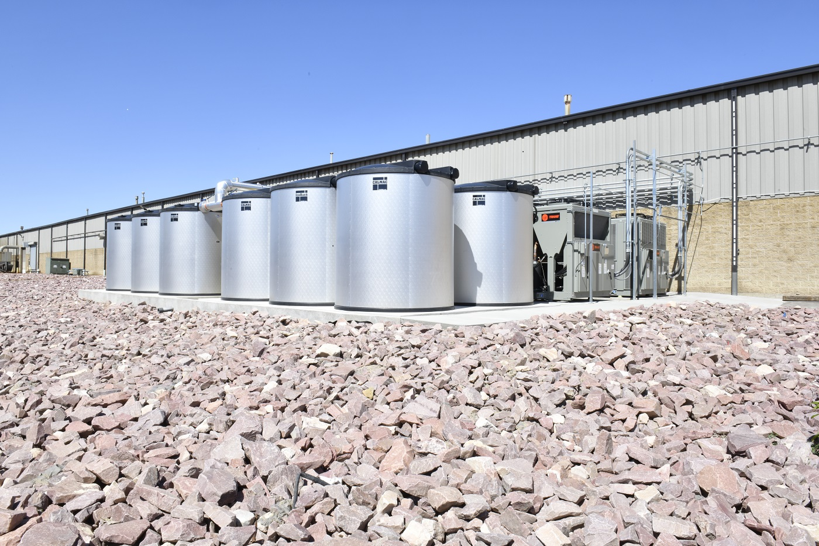
Ice thermal storage
Shift cooling to off-peak, reduce demand charges, improve resilience.
Charges ice tanks overnight using low-cost power.
Discharges during peak, cutting chiller load and grid draw.
Adds operational flexibility for data center cooling.
Confidential | FLEXERA

Slide 7
VPP-as-a-Service
Software + operations to aggregate and dispatch DERs and flexible loads.
Revenue streams: capacity, ancillary services, arbitrage, demand response.
Grid services for utilities and industrial/commercial clients.
Multi-site replication: repeatable playbook across regions.
Confidential | FLEXERA

Slide 8
Business model
Stacked, de-risked revenue with infrastructure-grade contracts.
Energy: PPAs, wheeling, firming contracts, storage services.
Data: colocation/lease, interconnect, managed security.
Flexibility: VPP dispatch fees + performance-based revenue share.
Confidential | FLEXERA

Slide 9
Why now
Policy tailwinds + AI demand + grid constraints.
Rapid data center expansion and AI workloads.
Increasing value of flexibility as grids decentralize.
Falling PV + storage costs improve project economics.
Confidential | FLEXERA

Slide 10
Roadmap
From concept to bankable execution.
Phase 1 | Land & permits, interconnect study, early offtake MoUs
Phase 2 | PV + BESS EPC, ICE storage integration, initial data halls
Phase 3 | Scale-out halls, replicate sites, expand VPP portfolio
Confidential | FLEXERA

Slide 11
Team
Experienced operators across energy, infrastructure and delivery.
Alassane Ndour
Business / Partnerships • ndoural2030@gmail.com
Eric Oben
Engineering / Delivery • eobenn@gmail.com
Confidential | FLEXERA

Slide 12
Investment opportunity
Seeking strategic capital to advance interconnect, permits and early build.
Use of funds: permitting, grid studies, EPC pre-dev, VPP platform build-out.
Target: secure anchor customers (energy + data) and reach financial close.
Contact: ndoural2030@gmail.com | eobenn@gmail.com
Confidential | FLEXERA

Slide 13
Training & Studies-as-a-Service
Capacity building + bankable advisory
Training: operator training, SOPs, O&M readiness for PV, BESS, VPP and thermal systems.
Studies: feasibility, interconnect, load modeling, techno-economic analysis and permitting support.
Outcome: de-risk delivery and accelerate replication across sites.
Confidential | FLEXERA

